Slide 1
Illinois Recidivism Studies
Improving State Criminal History Records: Recidivism of Sex Offenders Released in 2001
JRSA – Justice Research and Statistics Association
Stan Orchowsky & Janice Iwama (2009)
IL data - ICJIA
Are Sex Offenders Different? An Examination of Rearrest Patterns
Lisa L. Sample & Timothy M. Bray (2006)

Slide 2
Recidivism of Sex Offenders Released in 2001
Sex Offenders Released from IDOC in 2001 (n = 499)
OVERALL – within 3 years:
Percent rearrested (for anything): 30%
Percent reconvicted: 14%
Percent rearrested for a sex offense: 2.4%

Slide 3
Recidivism of Sex Offenders Released in 2001
Sex Offenders Released from IDOC in 2001 (n=499)
Rearrest rates by race:
White: 23%
Black: 50%
Hispanic: 18%

Slide 4
Recidivism of Sex Offenders Released in 2001
Sex Offenders Released from IDOC in 2001 (n=499)
Rearrest rates by age group:
18-24: 51%
25-29: 43%
30-34: 28%
35-39: 22%
40-44: 18%
45+ : 19%

Slide 5
Recidivism of Sex Offenders Released in 2001
Sex Offenders Released from IDOC in 2001 (n=499)
Rearrest rates by new offense type:
Violent: 6%
Property: 2%
Drug: 3%
Public Order: 10%
Other: 7%

Slide 6
An Examination of Rearrest Patterns in Illinois
Sample and Bray (2006)
Illinois CHRI data (arrests), 1990-1997
Different “types” of offenders had different recidivism rates
Type → sex crime they were arrested for

Slide 7
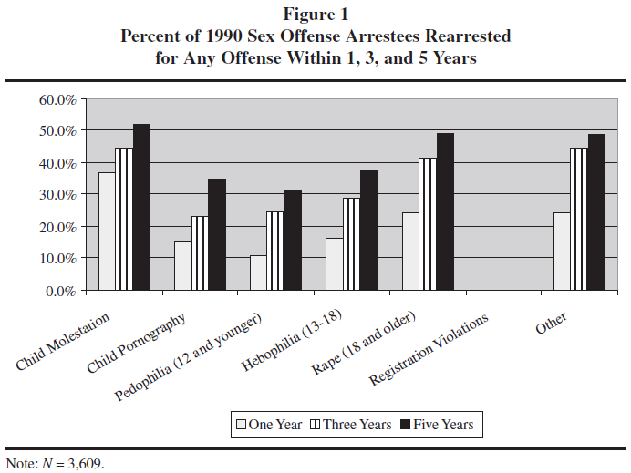
An Examination of Rearrest Patterns in Illinois

Slide 8
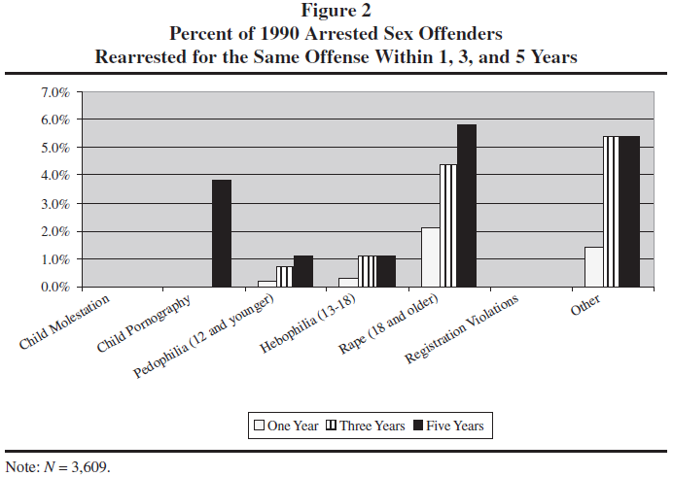
An Examination of Rearrest Patterns in Illinois

Slide 9
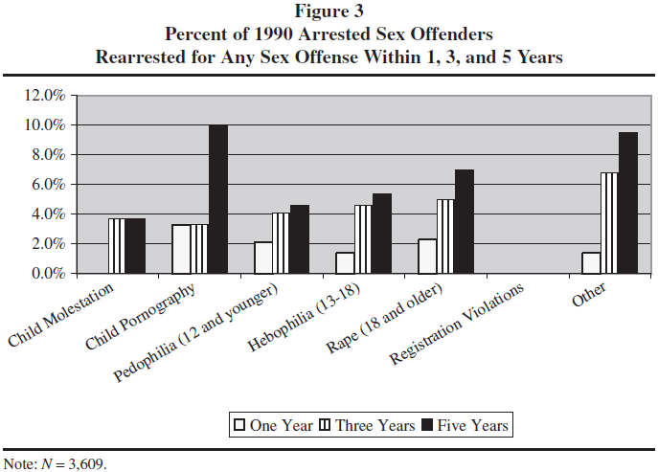
An Examination of Rearrest Patterns in Illinois

Slide 10
Future Illinois Recidivism Study
JAG Funded Study (2017) – ICJIA
All persons on the sex offender registry in Illinois

